Slide 1

Job Hunter
A Game About Getting a Job
Seb Kryspin

Slide 2
Getting a job can be fun(ny)!
Job Hunter will address fears of finding a job after graduation.
Wacky Characters
Sense of Humor
Laughter reduces anxiety, promotes learning [5]

Slide 3
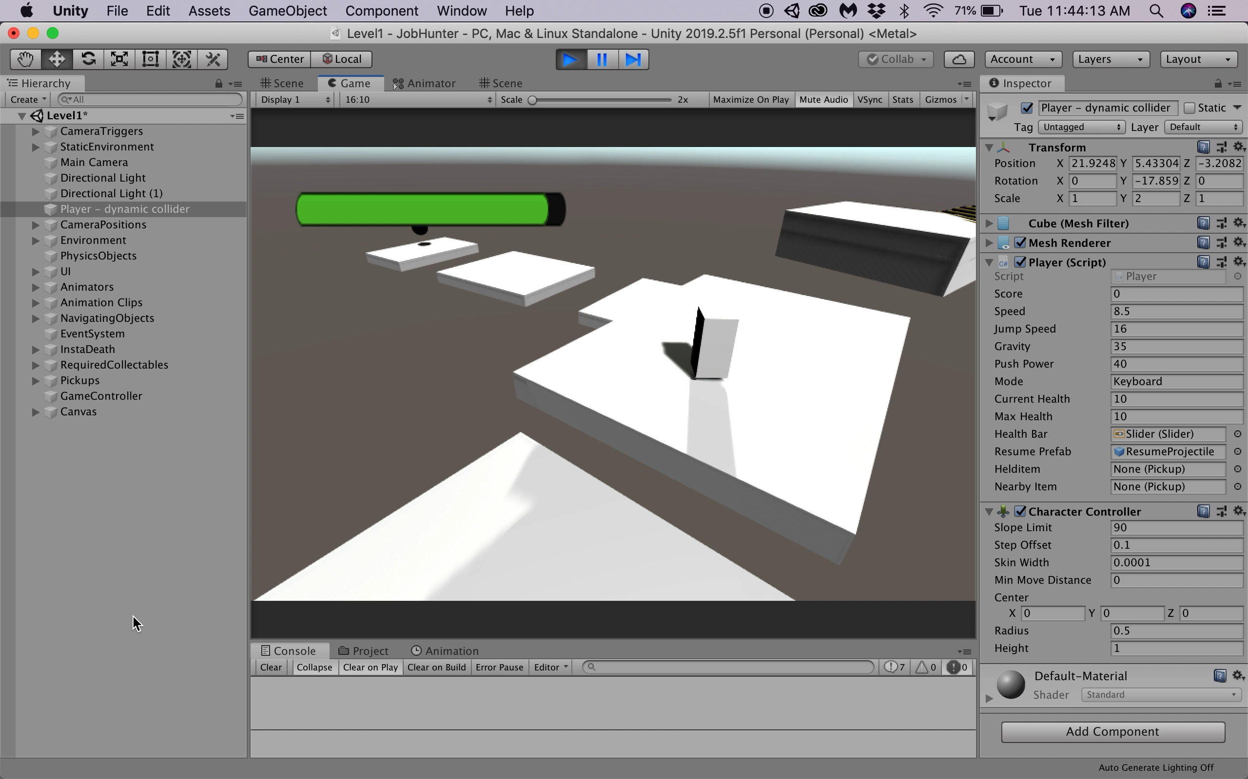
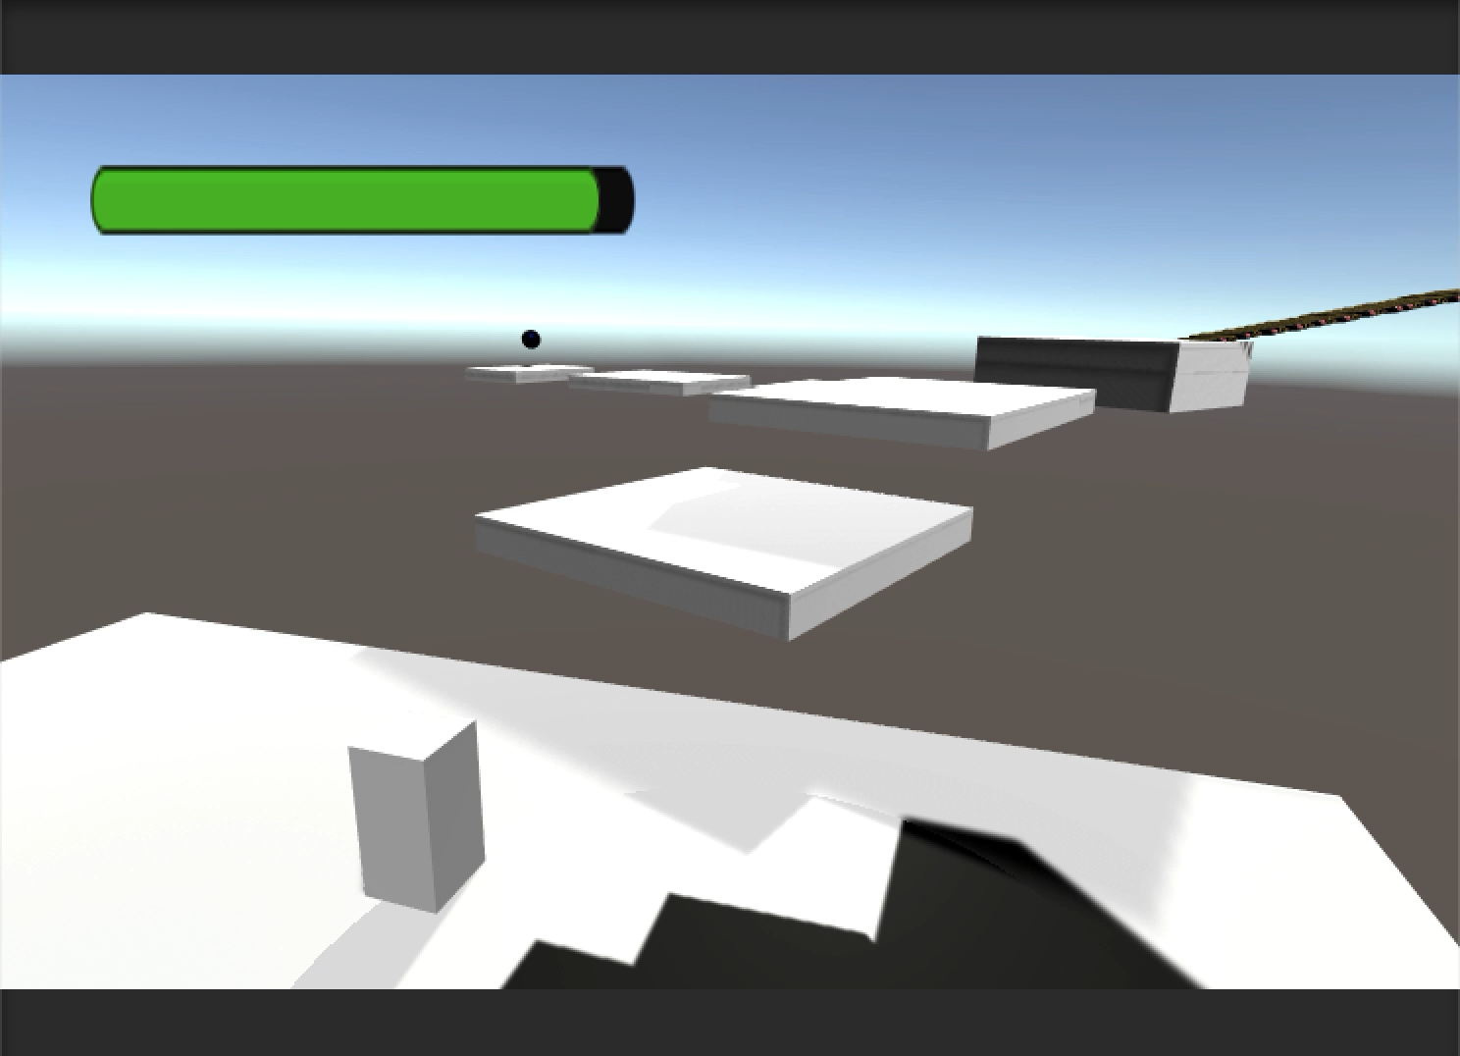
Movement
Jumping
Walking

Slide 4
Implementing a Jump

Slide 5
Jumping: A Naïve Approach
If player presses A
Raise Character by 1 Units

Slide 6

Jumping: A Naïve Approach
Player presses A
Frame 0
Frame 1
Frame 2

Slide 7

Jumping: A Naïve Approach
Player presses A
Frame 0
Frame 1
Frame 2

Slide 8
Jumping: A Slight Improvement
If player presses A
Raise Character by 1 Unit
Else
Put Character back on the Ground

Slide 9

Jumping: A Slight Improvement
Player presses A
Frame 0
Frame 1
Frame 2

Slide 10
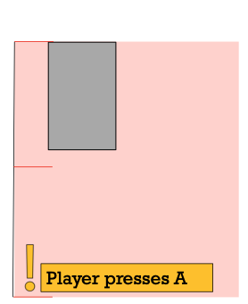
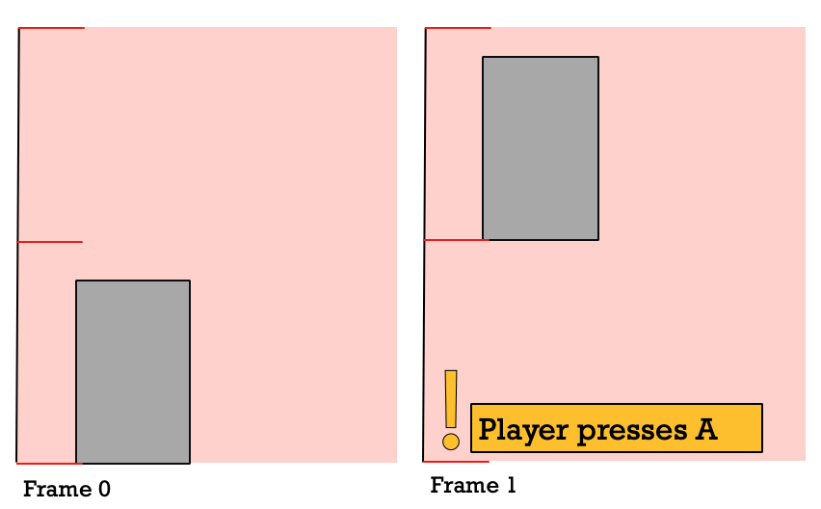
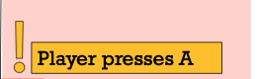
Jumping: What if the player does this?

Slide 11
Jumping: An Improvement
If player presses A and is On Ground
Raise Character by 1 Unit
Else
Put Character back on the Ground

Slide 12
Jumping: A Fundamental Problem
Frame by Frame
30 Frames Per Second (fps)
Airtime is .033 seconds
Player presses A
Frame 0
Frame 1
Frame 2

Slide 13
Jumping: A Rethinking
Apply jump movement as a Velocity
Reducing velocity each frame by applying gravity

Slide 14
Jumping: An Improvement
If player presses A and is On Ground
jumpVelocity is JUMP_SPEED
Else
jumpVelocity -= gravityVelocity
where gravityVelocity = GRAVITY * time.DeltaTime

Slide 15
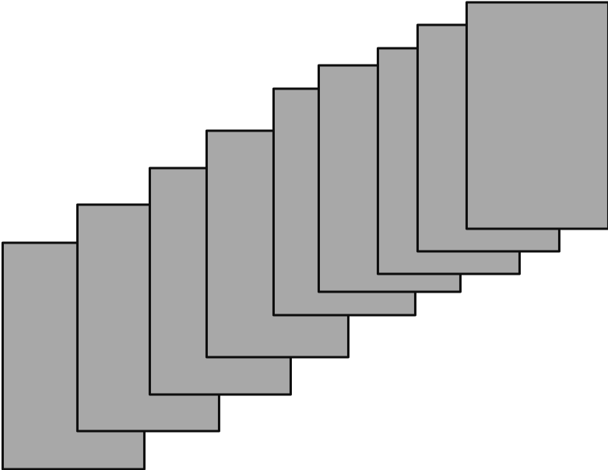
Jumping: An Improvement
Frame 8
Frame 7
Frame 9
Frame 6
Frame 9
Frame 5
Frame 10
Frame 4
Frame 11
Frame 3
Frame 12
Frame 2
Frame 13
Frame 1
Frame 14
Frame 0
Frame 15
Player presses A

Slide 16
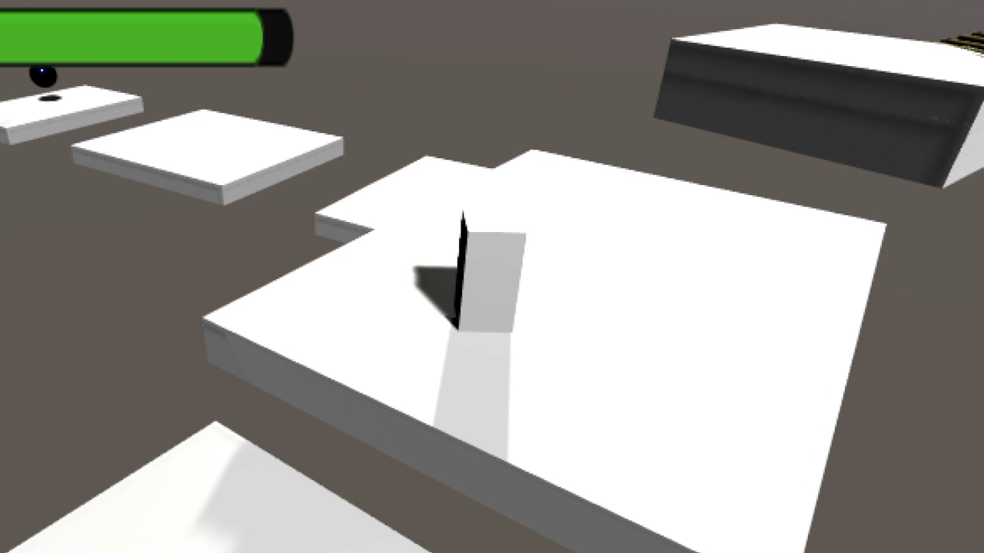
Jumping: More Control
Will always jump the same height
What if we want the player to be able to jump different heights?

Slide 17
Jumping: More Control
There are 3 ways to press any key
Press Down – first frame
Hold – subsequent frame
Release - last frame
Idea: Let players exit the jump early

Slide 18
Jumping: More Control
If player presses A and is On Ground
jumpVelocity is JUMP_SPEED
Else if player releases A
jumpVelocity = 0
Else
jumpVelocity -= gravityVelocity

Slide 19
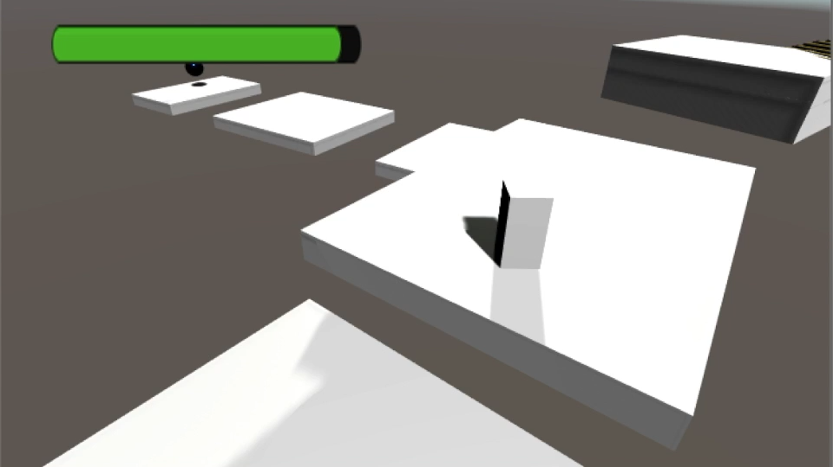
Jumping: A New Issue

Slide 20
Jumping: A New Issue
If player presses A and is On Ground
jumpVelocity is JUMP_SPEED
Else if player releases A and jumpVelocity > 0
jumpVelocity = 0
Else
jumpVelocity -= gravityVelocity

Slide 21

Jumping
Smooth jumping
Player controls height of jump
Player can only begin jump on ground

Slide 22
Implementing Movement

Slide 23
Unity 3D Space
Z
X

Slide 24

Direction of Movement
Z
Let UP = Z axis
Let RIGHT = X axis
UP
Confusing for player
RIGHT
X

Slide 25
Direction of Movement
Z
Let UP = Forward vector of camera
Let RIGHT = Right vector of camera
UP
RIGHT
X

Slide 26
Examples: Direction of Movement
Z
Z
Z
X
X
X
Z
Z
Z
X
X
X

Slide 28
Other Stuff I did
Designed & Programmed Level 1
Player Health & Death
Two enemies & animations
Picking up and Placing Items
Collectables
Basic Physics
Thank You

